Slide 1

Chapter 6:
Probability Distributions
^{Discovering Statistics}
^{2nd Edition Daniel T. Larose}
Lecture Powerpoint
Notes:
Basic Practice of Statistics - 3rd Edition
Chapter 5

Slide 2
6.1: Discrete Random Variables
Objectives:
Identify random variables.
Explain what a discrete probability distribution is and construct probability distribution tables and graphs.
Calculate the mean of a discrete random variable.

Slide 3

Random Variables
In this chapter, we develop an approach that analyzes probability problems more efficiently than we did in Chapter 5. Recall from Chapter 1 that a variable is a characteristic that can assume different values.
A random variable is a variable that takes on quantitative values representing the results of a probability experiment, and thus its values are determined by chance. We denote random variables using capital letters such as X, Y, or Z.
Example
Let X = outcome of a single roll of a die
X could be 1, 2, 3, 4, 5, 6
P(X = 5) = 1/6

Slide 4


Discrete and Continuous Random Variables
There are two main types of random variables. The difference between the two types relates to the possible values that each type of random variable can assume.
Discrete and Continuous Random Variables
A discrete random variable can take either a finite or a countable number of values. The values can be graphed as separate points on a number line.
A continuous random variable can take on infinitely many values. The values form an interval on the number line.

Slide 5
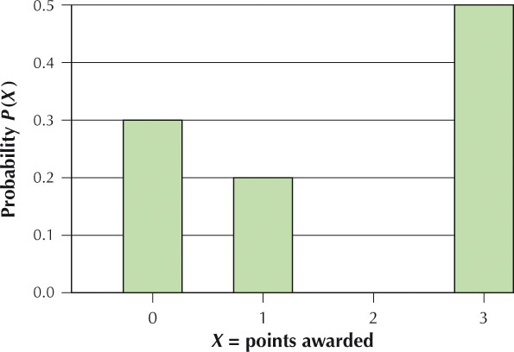
Discrete Probability Distributions
For every random variable, there is a probability distribution that allows us to view all possible values of the random variable at a glance.
A probability distribution of a discrete random variable provides all the possible values that the random variable can assume, together with the probability associated with each value. The probability distribution can take the form of a table, graph, or formula. Probability distributions describe populations, not samples.
When constructing a probability distribution of a discrete random variable,
Note each possible value of X
Note the probability associated with each value of X

Slide 6
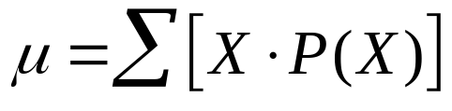
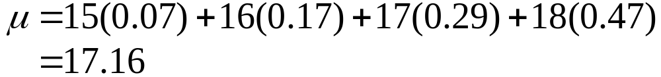
Mean of a Discrete Random Variable
We can calculate the mean and standard deviation of a discrete random variable X, just as we can calculate the mean and standard deviation of quantitative data.
Finding the Mean of a Discrete Random Variable X
The mean µ of a discrete random variable X is found as follows:
Multiply each possible value of X by its probability
Add the resulting products
X = age | P(X)
15 | 0.07
16 | 0.17
17 | 0.29
18 | 0.47
The mean µ of a discrete random variable is also called the expected value or the expectation of the random variable X, denoted as E(X).

Slide 7
6.2: Binomial Probability Distribution
Objectives:
Explain what constitutes a binomial experiment.
Compute probabilities using the binomial probability formula.
Find probabilities using the binomial tables.
Calculate the mean, variance, and standard deviation of the binomial random variable and find the mode of the distribution.

Slide 8
Binomial Experiments
Many situations involve only two possible outcomes to a process. Methods have been developed to make it more convenient to analyze them. These methods begin with the definition of a binomial experiment.
Binomial Experiment
A probability experiment that satisfies the following four requirements is said to be a binomial experiment:
Each trial of the experiment has only two possible outcomes. One outcome is denoted a success and the other a failure.
There is a fixed number of trials, known in advance.
The experimental outcomes are independent of each other.
The probability of observing a success is the same from trial to trial.

Slide 9
Binomial Experiments
The outcomes of a binomial experiment, together with their probabilities, generate a special discrete probability distribution called the binomial probability distribution.
Notation for Binomial Experiments and Binomial Distribution
Symbol Meaning
S The outcome denoted as a success
F The outcome denoted as a failure
P(Success)=P(S)=p The probability of observing a success
P(Failure)=P(F)=1-p The probability of observing a failure
n The number of trials

Slide 10
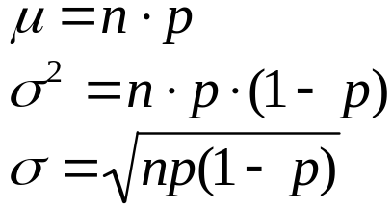
Binomial Mean, Variance, and Standard Deviation, and Mode
Since the binomial random variable X is discrete, it also has a mean, variance, and standard deviation.
Mean, Variance, and Standard Deviation of a Binomial Random Variable X
Mean (or expected value):
Variance:
Standard deviation:
The mode of a binomial distribution is the most likely outcome of the binomial experiment for the given values of n, p, and X, that is, the outcome with the largest probability.

Slide 11

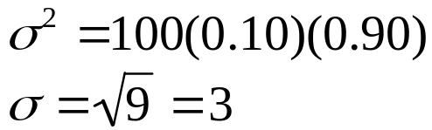
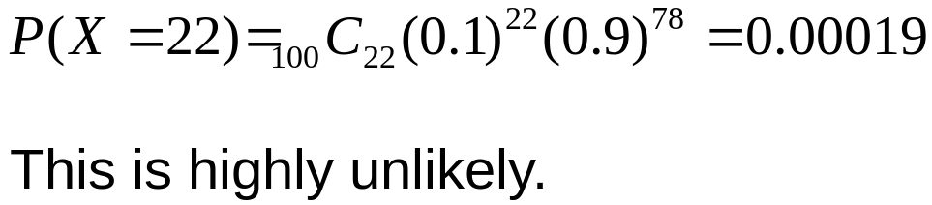
Binomial Example
Suppose we know the population proportion p of left-handed students is 0.10, and we have a random sample of 100 students.
Calculate the expected number of left-handed students.
Calculate the variance and standard deviation of the number of left-handed students.
Would 22 left-handed students out of 100 be considered an outlier?

Slide 12
6.4: Continuous Random Variables and the Normal Probability Distribution
Objectives:
Identify a continuous probability distribution and state the requirements.
Explain the properties of the normal probability distribution.

Slide 13
Continuous Probability Distributions
Continuous random variables assume infinitely many possible values, with no gap between the values. For a given continuous random variable X, we are not interested in whether X equals any particular value. Rather we are interested in whether X is greater or less than a particular value or between two values.
Continuous Probability Distribution
A continuous probability distribution is a graph that indicates the range of values that the continuous random variable X can take and, above which, is drawn a density curve.
The total area under the density curve must equal 1 (this is the Law of Total Probability for Continuous Random Variables)
The vertical height of the density curve can never be negative. That is, the density curve never goes below the horizontal axis.

Slide 14
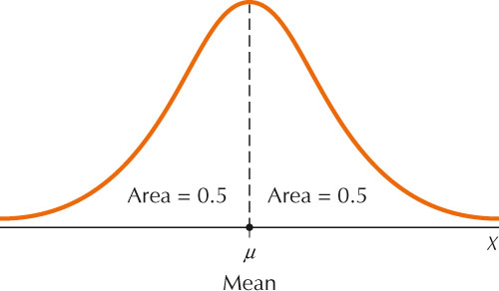
Normal Probability Distribution
We now turn to what is considered to be the most important probability distribution in statistics:
the normal probability distribution.
Properties of the Normal Probability Distribution
It is symmetric about the mean µ.
The highest point occurs at X=µ.
The total area under the curve = 1.
The area under the curve to the left of µ and to the right of µ are both equal to 0.5.
The normal distribution is defined for values of X extending indefinitely in both the positive and negative directions.
Values of X are always found on the horizontal axis. Probabilities are represented by areas under the curve.

Slide 15
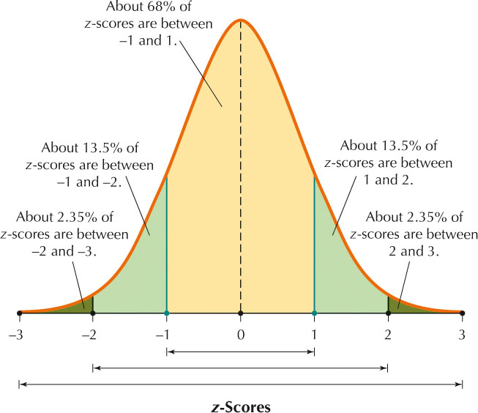
The Empirical Rule

Slide 16
6.5: Standard Normal Distribution
Objectives:
Find areas under the standard normal curve, given a Z-value.
Find the standard normal Z-value, given an area.

Slide 17
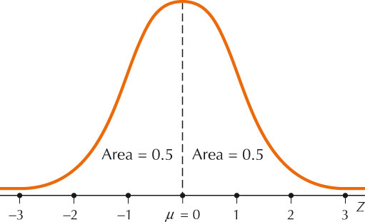
Standard Normal Distribution
There is one very special normal distribution called the standard normal distribution. The mean and standard deviation of the standard normal distribution make it unique.
The standard normal distribution is a normal distribution with
mean µ = 0 and
standard deviation σ = 1.

Slide 18
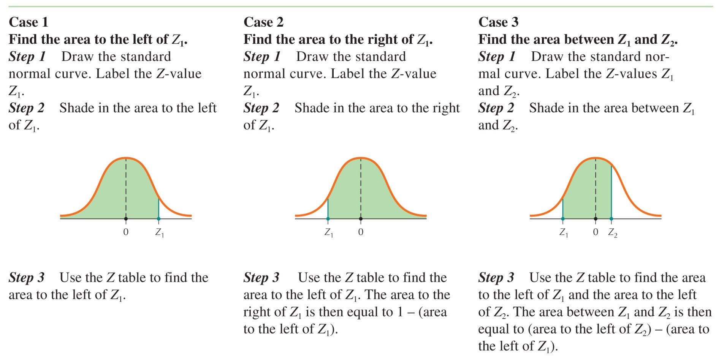
Finding Areas Under the Standard Normal Curve

Slide 19
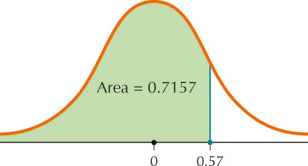
Finding Areas Under the Standard Normal Curve: Case 1
Find the area to the left of Z = 0.57.
1. Draw the standard normal curve and label Z = 0.57.
2. Shade to the left of 0.57.
3. Look at the intersection of row 0.5 and
column 0.07. This is the area to the left of
Z = 0.57.
Area = 0.7157.

Slide 20
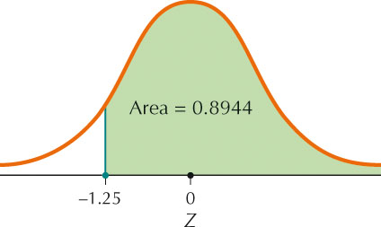
Finding Areas Under the Standard Normal Curve: Case 2
Find the area to the right of Z = -1.25.
1. Draw the standard normal curve and label Z = -1.25.
2. Shade to the right of -1.25.
3. Look at the intersection of row -1.2 and
column 0.05. This is the area to the left of
Z = -1.25. The area to the right is then
Area = 1 – 0.1056 = 0.8944.

Slide 21
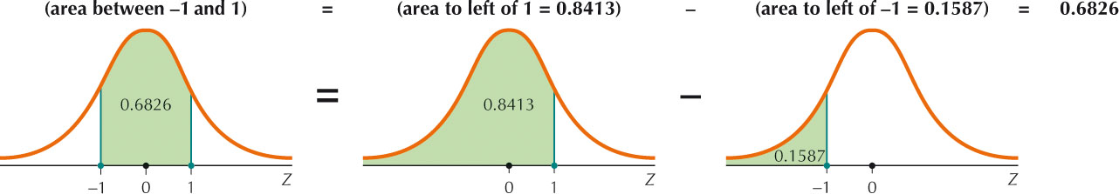
Finding Areas Under the Standard Normal Curve: Case 3
Find the area between Z = -1 and Z = 1.
1. Draw the standard normal curve and label Z = -1 and Z = 1.
2. Shade the area between -1 and 1.
3. Find the area to the left of Z = -1 and the area to the left of Z = 1. Subtract the smaller area from the larger area to find the area in between.
Area = 0.8413 – 0.1587 = 0.6826.

Slide 22
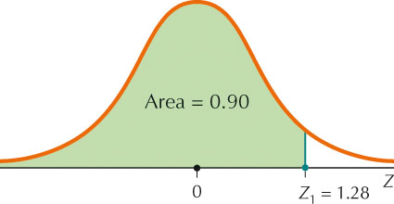
Finding Z-Values for a Given Area
Find the Z-value with area 0.90 to its left.
1. Draw the standard normal curve and label Z₁
2. Shade the area to the left of Z₁ and label with the given area of 0.90.
3. Find the value closest to 0.90 in the body of the Z table. This should be 0.8997. Move to the left to find the value 1.2, then move up from 0.8997 to find the value 0.08. Putting these values together, we get
Z₁ = 1.2 + 0.08 = 1.28

Slide 23
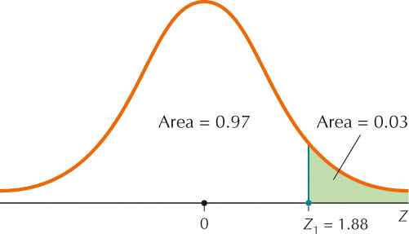
Finding Z-Values for a Given Area
Find the Z-value with area 0.03 to its right.
1. Draw the standard normal curve and label Z₁
2. Shade the area to the right of Z₁ and label with the given area of 0.03. Label the area to the left as 0.97
3. Find the value closest to 0.97 in the body of the Z table. This should be 0.9699. Move to the left to find the value 1.8, then move up from 0.9699 to find the value 0.08. Putting these values together, we get
Z = 1.8 + 0.08 = 1.88

Slide 24
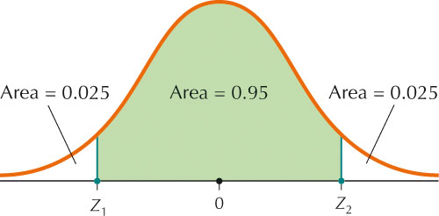
Finding Z-Values for a Given Area
Find the Z-values that mark the boundaries of the middle 95% of the area under the standard normal curve.
1. Draw the standard normal curve and label Z₁ and Z₂
2. Shade the area in between and label the area as 0.95. By symmetry, there is area 0.05 ÷ 2 = 0.025 in each tail.
3. Find the value closest to 0.025 in the body of the Z table. This corresponds to a Z-value of -1.96. By symmetry, the other Z-value is 1.96.

Slide 25
6.6: Applications of the Normal Distribution
Objectives:
Compute probabilities for a given value of any normal random variable.
Find the appropriate value of any normal random variable, given an area or probability.

Slide 26
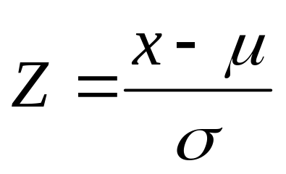
Standardizing a Normal Random Variable
To standardize a normal random variable X, we transform that normal random variable X into the standard normal random variable Z.
Standardizing a Normal Random Variable
Any normal random variable X can be transformed into the standard normal random variable Z by standardizing X using the formula

